Slide 1
Existing Traffic Management Systems in Hong Kong
Steven Lai

Slide 2
Some Existing Traffic Information
Data Source: Annual Traffic Census 2005 (latest) from Transport Department
Data is obtained from ‘Count Stations’.
Totally 829 counting stations were surveyed in 2005.
This represents 51.2% of the total number of counting stations in the whole territory.

Slide 3
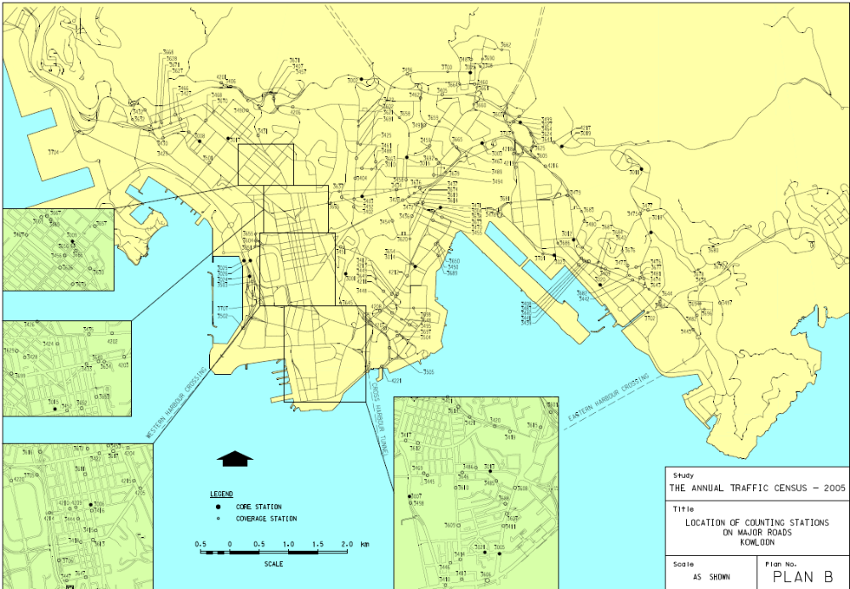
Count Stations - Kowloon

Slide 4
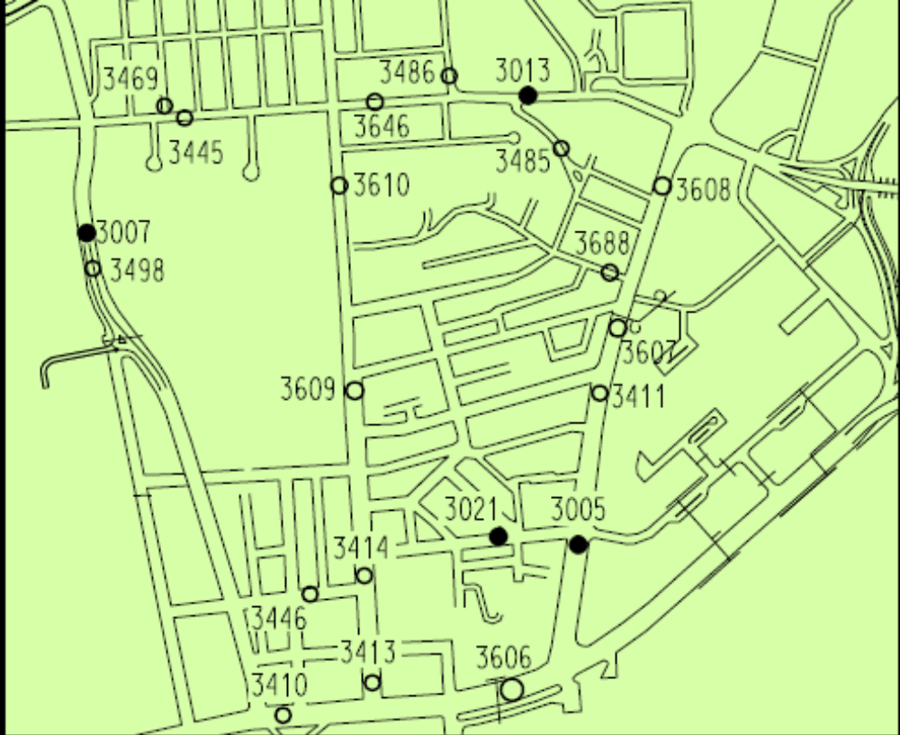
Count Stations - Kowloon

Slide 5
Example – Station 3006
Year: 2005
Link: NATHAN RD (from SHANTUNG ST to DUNDAS ST)
Road Network: Major
Road Type: Primary Distributor

Slide 6
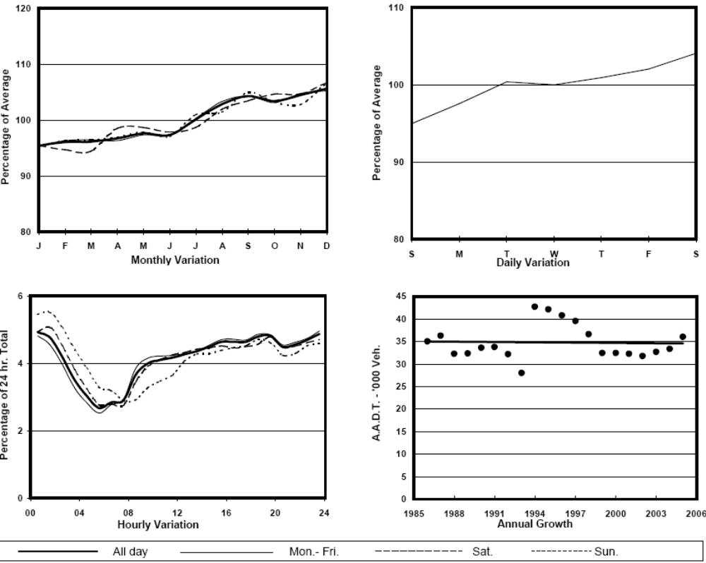
Traffic Flow Variation and Growth

Slide 7
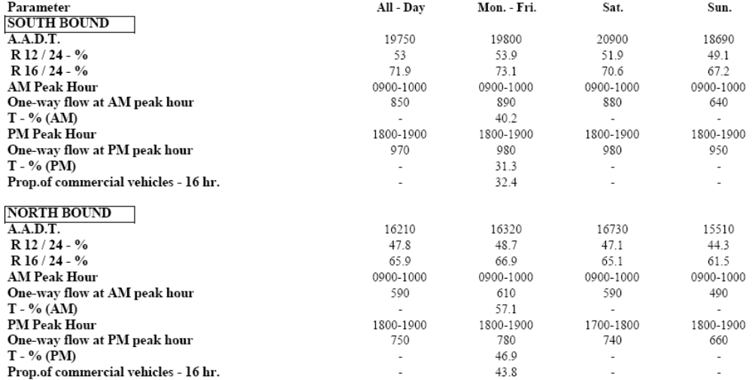
Traffic Characteristics (by Direction)

Slide 8
Legend
AADT: Annual Average Daily Traffic.
R 12 / 24 - %: Ratio between the traffic flow before 12:00 and the total traffic flow?
T - % (AM): ???

Slide 9
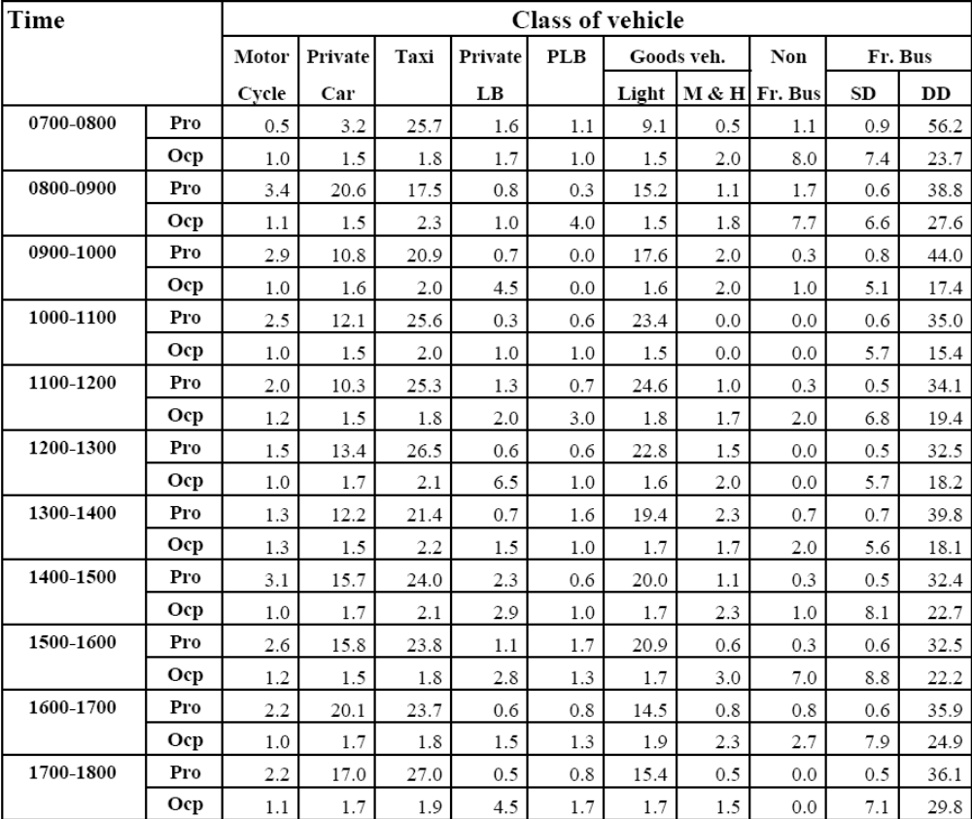
Vehicle Classification and Occupancy

Slide 10
Legend
Pro. Proportion of vehicles in % (Sum may not add up to 100% due to figure rounding)
Ocp. Average occupancy of vehicles
M&H Medium and Heavy

Slide 11
Possible Research Issues
What is the technology used in those count stations? Will WSN be a better way?
How can the sensor nodes work together to obtain such kind of statistics information?
How can the sensors automatically classify the vehicles? Any distributed data mining techniques involved (based on the length, speed detected by the sensors)?
Traffic flow prediction may be useful for the wakeup scheduling in my Traffic System.

